Slide 1

MSc Health Data Science

Slide 2

MSc Health Data Science

Slide 3
Msc Health Data Science
Programme Director: Dr Pete Arnold
Senior Academic Mentor: Judy Jenkins
Administrator: Jill Davies
Module Co-ordinators:
PMIM102: Dan Thayer
PMIM202: Dr Pete Arnold
PMIM302: Professor Tom Briffa
PMIM402: Dr Arron Lacey
PMIM502: Dr Rich Fry
PMIM602: Professor David Preen
PMGM00: Dr Anna Derrick

Slide 4
What is Health Data Science?
Health Data Science is the science/art of understanding complex health issues through careful study design, the creation, discovery and processing of appropriate data (potentially across several domains) and the interpretation and communication of your analyses to produce data-driven solutions.
Health Data Science is a multi-displinary field involving statistics, computer science, and medicine.
A data scientist‘s job is to use tools and methods from statistics and machine learning to piece together relevant data, building models and algorithms to create insight into big data for companies. [Royal Statistical Society]

Slide 5
MSc HDS Learning Outcomes
By the end of this course, students should:
have developed knowledge and understanding of the theory of health data science and its application to practice.
have developed analytical and communication skills in health data science.
be able to continue their professional and academic development in health data science through advanced theoretical studies and the submission of a dissertation.
have enhanced their employability as health data scientists in the NHS and other employers through the development of specialist knowledge and research skills.
have developed the health data science profession by enhancing knowledge and awareness in the field.
have developed knowledge and skills that will enable qualification for membership of relevant professional bodies.

Slide 6
MODULE AND ASSIGNMENT TIMETABLE
 | January Intake - MSc Health Data Science 2020 – 2021 Module & Assignment Timetable
MONTH | MODULE | WEB ACCESS | TAUGHT WEEK | STUDY GROUP | TUTORIAL | ASSIGNMENT DATE | WRITING TIME | PROVISIONAL MARKS
JAN 2021 FT and Year 1 PT | PMIM102 Scientific Computing and Health Care Mr Dan Thayer | 04/01/21 | 18/01/21 | 27/01/21 | 19/02/21 | 08/03/21 | 6 weeks | 29/03/21
FEB 2021 FT and Year 1 PT | PMIM302 Introductory Analysis of Linked Health Data Prof Tom Briffa (UWA) | 25/01/21 | 08/02/21 | 03/02/21 17/02/21 24/02/21 | 26/02/21 | 29/03/21 | 6 weeks | 19/04/21
MAR 2021 FT and Year 2 PT | PMIM402 Machine Learning in Healthcare Dr Arron Lacey | 22/02/21 | 08/03/21 | 03/03/21 17/03/21 24/03/21 31/03/21 | 01/04/21 | 26/04/21 | 6 weeks | 17/05/21
MAR 2021 FT and Year 1 PT | **PMGM00 Bioinformatics for Genome Analysis Dr Anna Derrick | 08/03/21 | 22/03/21 | TBA | Via email or discussion board | 26/03/21 (MCQ) 12/04/21 (A1) 10/05/21 (A2) | 0 weeks 2 weeks 6 weeks | 26/03/21 26/04/21 24/05/21
APR 2021 FT and Year 2 PT | PMIM602 Advanced Analysis of Linked Health Data Prof David Preen (UWA) | 05/04/21 | 19/04/21 | 07/04/21 14/04/21 28/04/21 | 07/05/21 | 31/05/21 | 5 weeks | 21/06/21
MAY 2021 FT and Year 2 PT | PMIM502 Health Data Visualisation Dr Richard Fry | 03/05/21 | 17/05/21 | 05/05/21 12/05/21 26/05/21 | 04/06/21 | Presentations 5th – 7th July 2021 | 6 weeks | 02/08/21
JUN 2021 FT and Year 1 PT | PMIM202 Health Data Modelling Dr Pete Arnold | 31/05/21 | 14/06/21 | 02/06/21 09/06/21 23/06/21 30/06/21 | 09/07/21 | 02/08/21 | 6 weeks | 23/08/21
PART II | DISSERTATION |  |  | VIVA | SUBMISSION DATE |  | PROVISIONAL MARKS
 | PMIM702 |  |  | 29/11/21 – 01/12/21 | 15/12/21 |  | TBA
Timetable
Notes:
1st in the UK for Research Environment, 2nd in the UK for Research Quality – Research Framework (Research Excellence Framework 2014)
.
Postgraduate students have access to facilities in the £100 million Institute of Life Science building
.
What Uni? Student Choice Award 2017 Winner – Postgraduate
.
Degree is available as either one year full time or part-time over three years
.
Strong links with the NHS and organisations within the Life Science Sector
.
Strong collaborative links with colleagues from the Centre for Health Services Research of the University of Western Australia, a group of leading experts in the analysis of linked health data
.
Hands on experiential learning from the professionals behind the Secure Anonymised Information Linkage (SAIL) Databank, a UK-exemplar project for the large scale mining of healthcare data within a secure environment

Slide 7
MSc Health Data Science Options
PMIM102 – PMIM502 Compulsory modules.
Final module has a choice:
PMIM602: Advanced Analysis of Linked Health Data
PMGM00: Bioinformatics for Genome Analysis
Notes:
1st in the UK for Research Environment, 2nd in the UK for Research Quality – Research Framework (Research Excellence Framework 2014)
.
Postgraduate students have access to facilities in the £100 million Institute of Life Science building
.
What Uni? Student Choice Award 2017 Winner – Postgraduate
.
Degree is available as either one year full time or part-time over three years
.
Strong links with the NHS and organisations within the Life Science Sector
.
Strong collaborative links with colleagues from the Centre for Health Services Research of the University of Western Australia, a group of leading experts in the analysis of linked health data
.
Hands on experiential learning from the professionals behind the Secure Anonymised Information Linkage (SAIL) Databank, a UK-exemplar project for the large scale mining of healthcare data within a secure environment

Slide 8
PMIM302:Introductory Analysis of Linked Health Data
Day 1: INTRODUCTION TO DATA LINKAGE SYSTEMS
Case Studies of Data Linkage Systems / Use of Computing Syntax in Linked Data Analysis
Day 2: CHARACTERISING POPULATIONS USING LINKED DATA
Theory of Data Linkage Methods and Applications / Preparing a Linked Data File and Characterising a Population
Day 3: MEASURING HEALTH AND SERVICES USING LINKED DATA
Theory of Measurement of Health Events and States / Monitoring Health Care Utilisation with Linked Data
Day 4: OUTCOMES RESEARCH USING LINKED DATA
Theory of Measurement of Health Outcomes / Health Outcomes Research Using Linked Data
Day 5: RISK ADJUSTMENT USING LINKED DATA
Theory of Risk Adjustment / Risk Adjustment with Linked Data
Notes:
1st in the UK for Research Environment, 2nd in the UK for Research Quality – Research Framework (Research Excellence Framework 2014)
.
Postgraduate students have access to facilities in the £100 million Institute of Life Science building
.
What Uni? Student Choice Award 2017 Winner – Postgraduate
.
Degree is available as either one year full time or part-time over three years
.
Strong links with the NHS and organisations within the Life Science Sector
.
Strong collaborative links with colleagues from the Centre for Health Services Research of the University of Western Australia, a group of leading experts in the analysis of linked health data
.
Hands on experiential learning from the professionals behind the Secure Anonymised Information Linkage (SAIL) Databank, a UK-exemplar project for the large scale mining of healthcare data within a secure environment

Slide 9
PMIM602:Advanced Analysis of Linked Health Data
Day 1: PRINCIPLES OF ADVANCED LINKED DATA ANALYSIS
Transition from Introductory to Advanced Analytical Concepts / Preparing a Complex File Group for Analysis
Day 2: CLINICAL POPULATION DYNAMICS USING LINKED DATA
Advanced Topics in Clinical Population Dynamics / Health Occurrences in Partitioned At Risk Populations
Day 3: COMPLEX LONGITUDINAL DESIGNS USING LINKED DATA
Advanced Topics in Longitudinal Research Design / Implementing Complex Longitudinal Designs
Day 4: CASE DISTRIBUTION DESIGNS USING LINKED DATA
Advanced Topics in Case Distribution Studies / Implementing Case Distributions Designs
Day 5: RISK MODIFICATION AND ADJUSTMENT USING LINKED DATA
Advanced Topics in External and Internal Validity of Effect Measures / Optimising Effect Estimation
Notes:
1st in the UK for Research Environment, 2nd in the UK for Research Quality – Research Framework (Research Excellence Framework 2014)
.
Postgraduate students have access to facilities in the £100 million Institute of Life Science building
.
What Uni? Student Choice Award 2017 Winner – Postgraduate
.
Degree is available as either one year full time or part-time over three years
.
Strong links with the NHS and organisations within the Life Science Sector
.
Strong collaborative links with colleagues from the Centre for Health Services Research of the University of Western Australia, a group of leading experts in the analysis of linked health data
.
Hands on experiential learning from the professionals behind the Secure Anonymised Information Linkage (SAIL) Databank, a UK-exemplar project for the large scale mining of healthcare data within a secure environment

Slide 10
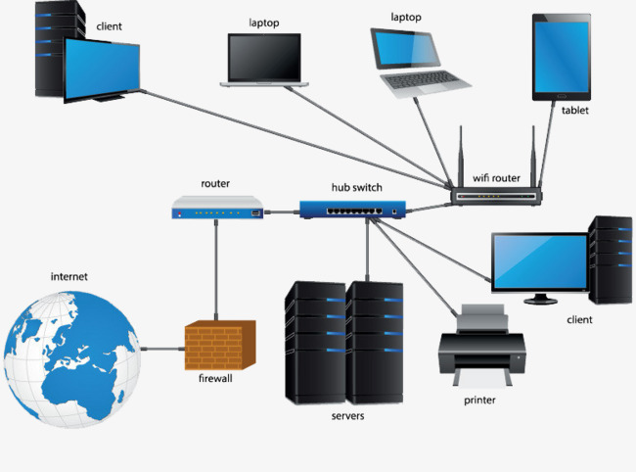

PMGM00:Bioinformatics for Genome Analysis
Bioinformatics
Computer Systems/Networks
Biological
Systems/Networks
Storing, retrieving and analysing large amounts of biological information.
Notes:
1st in the UK for Research Environment, 2nd in the UK for Research Quality – Research Framework (Research Excellence Framework 2014)
.
Postgraduate students have access to facilities in the £100 million Institute of Life Science building
.
What Uni? Student Choice Award 2017 Winner – Postgraduate
.
Degree is available as either one year full time or part-time over three years
.
Strong links with the NHS and organisations within the Life Science Sector
.
Strong collaborative links with colleagues from the Centre for Health Services Research of the University of Western Australia, a group of leading experts in the analysis of linked health data
.
Hands on experiential learning from the professionals behind the Secure Anonymised Information Linkage (SAIL) Databank, a UK-exemplar project for the large scale mining of healthcare data within a secure environment

Slide 11
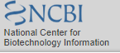
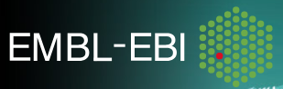
PMGM00:Bioinformatics for Genome Analysis
Nucleotide and Amino Acid Sequence Databases
Using the following sequence databases:
NCBI - GenBank
EMBL-ENA - Ensembl
Genomic-Variant Nomenclature.
Sequence Alignment Tools - BLAST
Notes:
1st in the UK for Research Environment, 2nd in the UK for Research Quality – Research Framework (Research Excellence Framework 2014)
.
Postgraduate students have access to facilities in the £100 million Institute of Life Science building
.
What Uni? Student Choice Award 2017 Winner – Postgraduate
.
Degree is available as either one year full time or part-time over three years
.
Strong links with the NHS and organisations within the Life Science Sector
.
Strong collaborative links with colleagues from the Centre for Health Services Research of the University of Western Australia, a group of leading experts in the analysis of linked health data
.
Hands on experiential learning from the professionals behind the Secure Anonymised Information Linkage (SAIL) Databank, a UK-exemplar project for the large scale mining of healthcare data within a secure environment

Slide 12
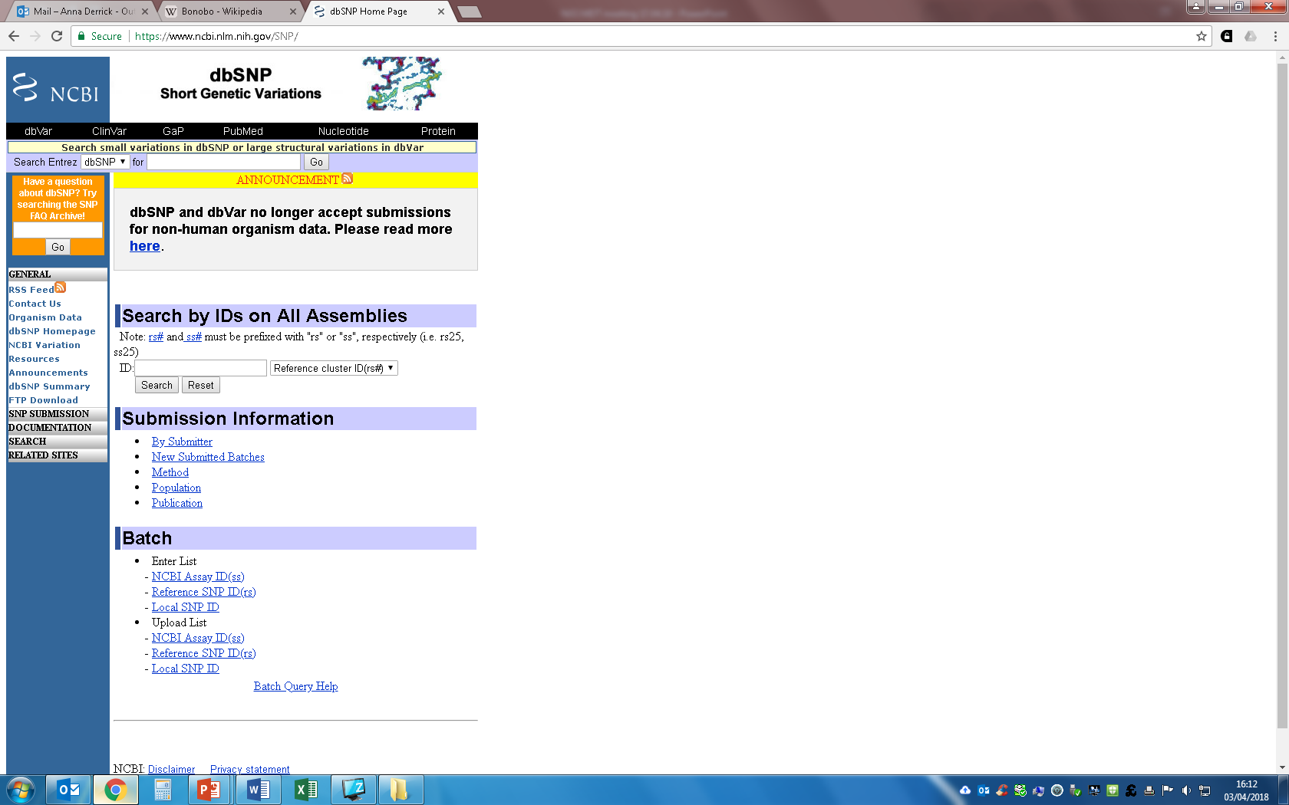
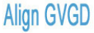
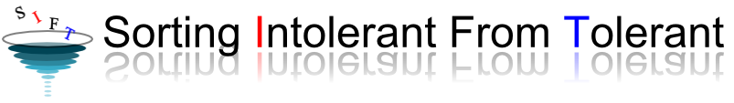
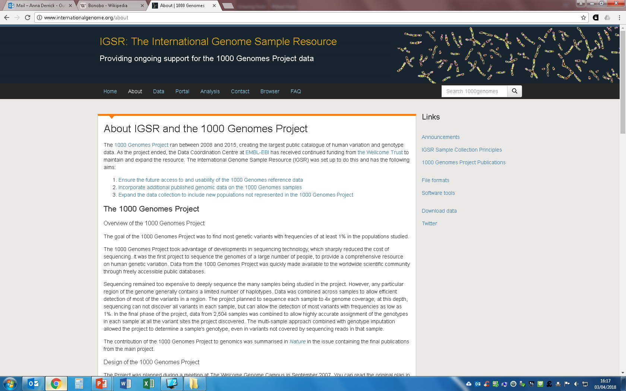
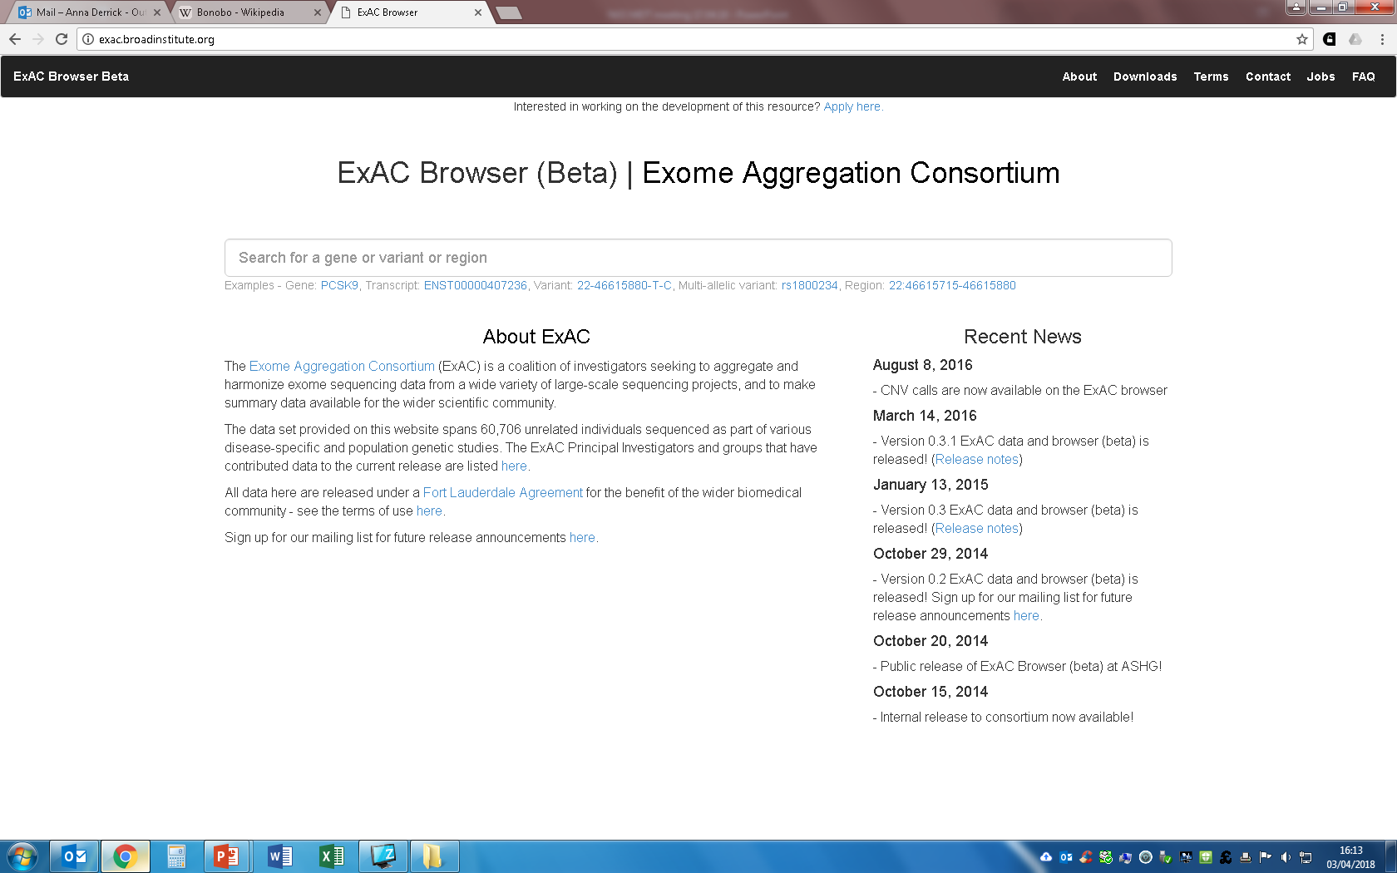
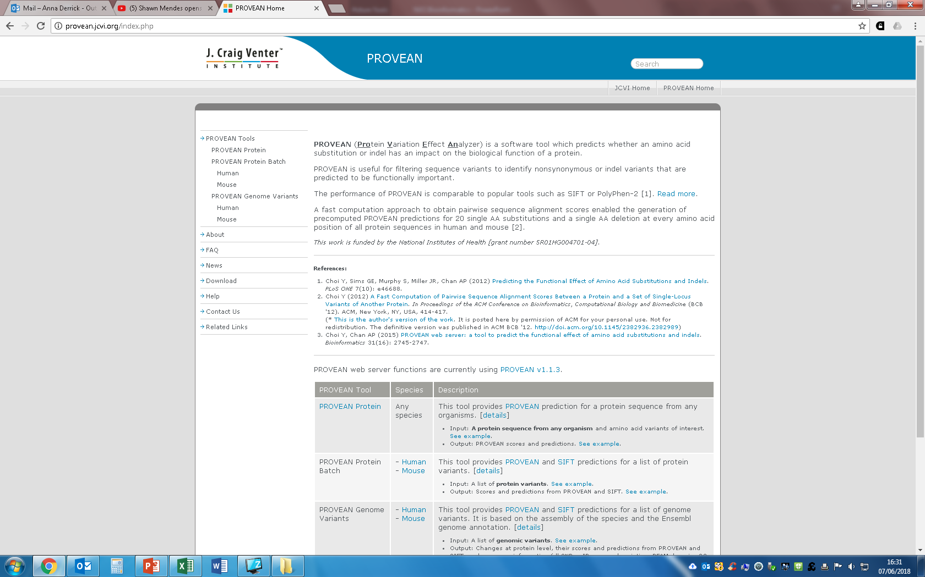
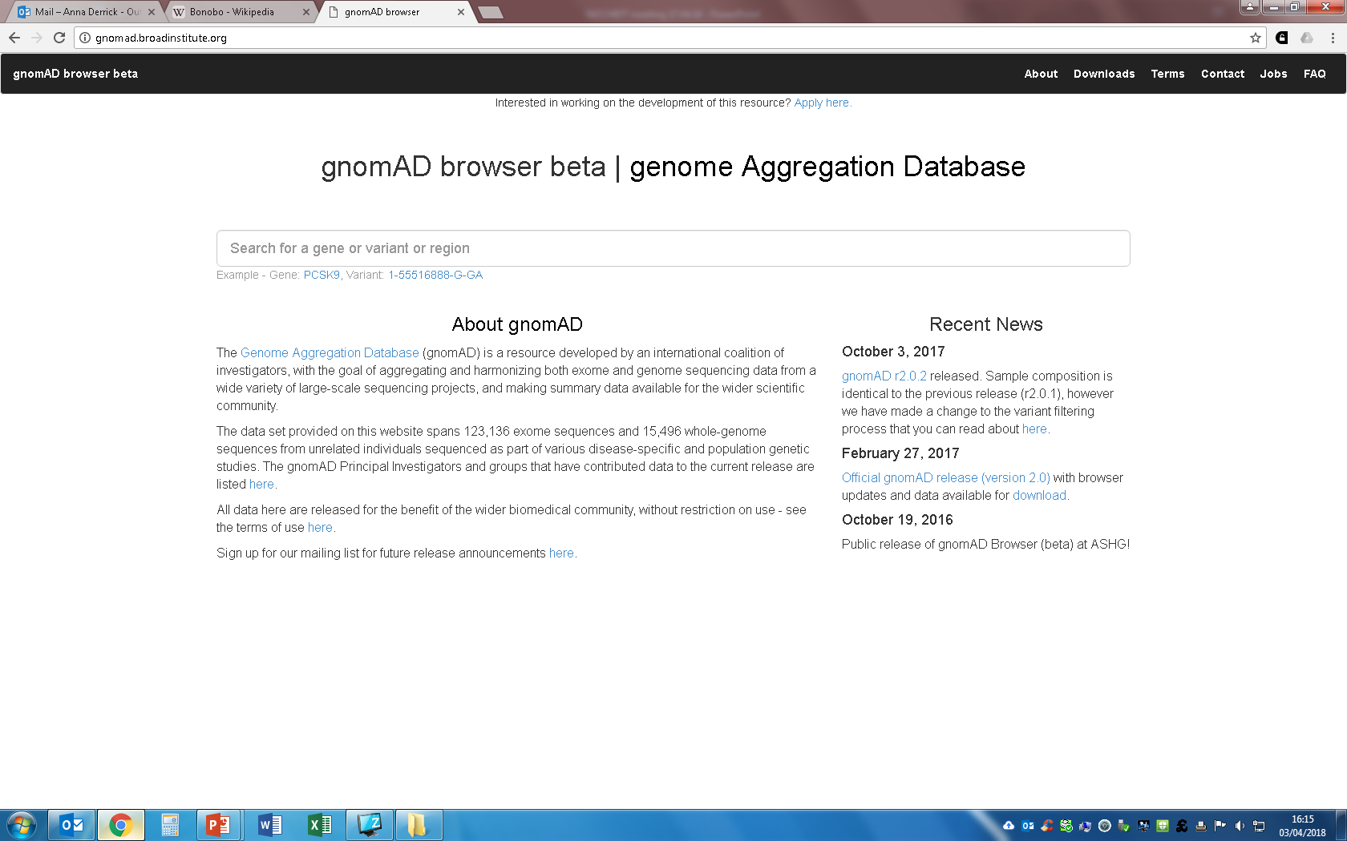
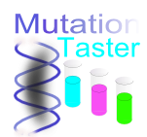
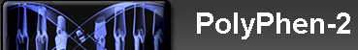
PMGM00:Bioinformatics for Genome Analysis
Databases and Tools to Analysis Genomic-Variants
Population Frequency Databases
Tools for Predicting Protein Pathogenicity
Notes:
1st in the UK for Research Environment, 2nd in the UK for Research Quality – Research Framework (Research Excellence Framework 2014)
.
Postgraduate students have access to facilities in the £100 million Institute of Life Science building
.
What Uni? Student Choice Award 2017 Winner – Postgraduate
.
Degree is available as either one year full time or part-time over three years
.
Strong links with the NHS and organisations within the Life Science Sector
.
Strong collaborative links with colleagues from the Centre for Health Services Research of the University of Western Australia, a group of leading experts in the analysis of linked health data
.
Hands on experiential learning from the professionals behind the Secure Anonymised Information Linkage (SAIL) Databank, a UK-exemplar project for the large scale mining of healthcare data within a secure environment

Slide 13



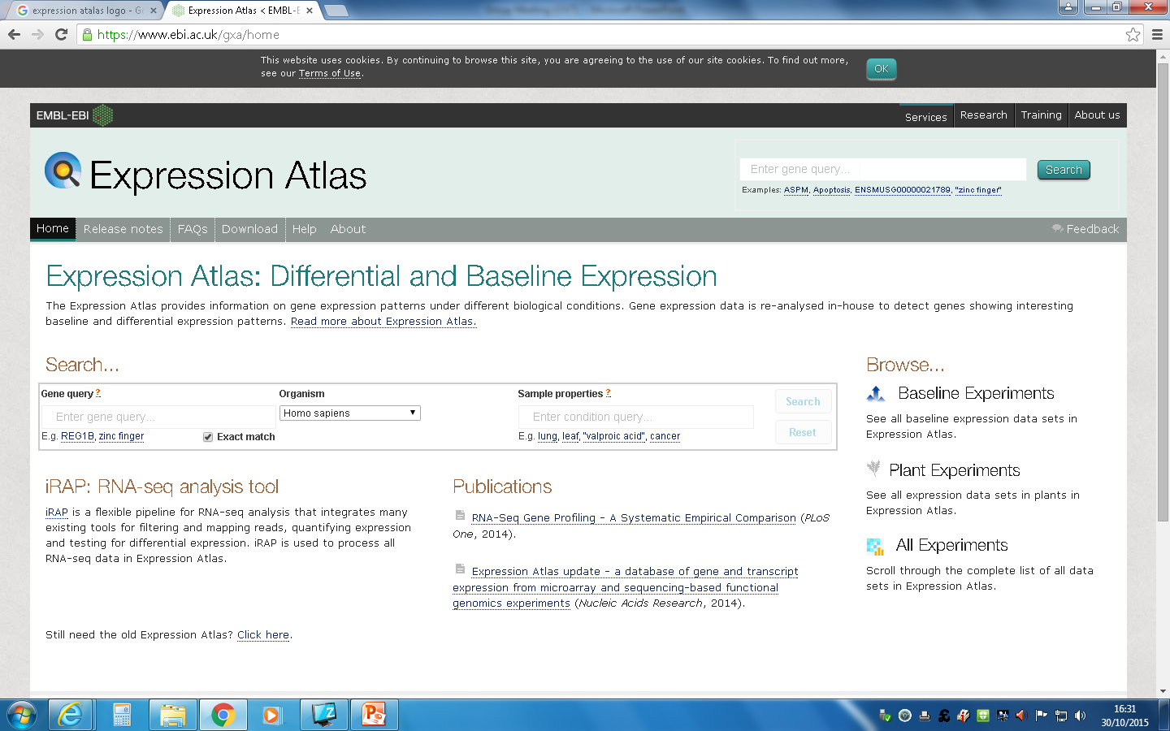


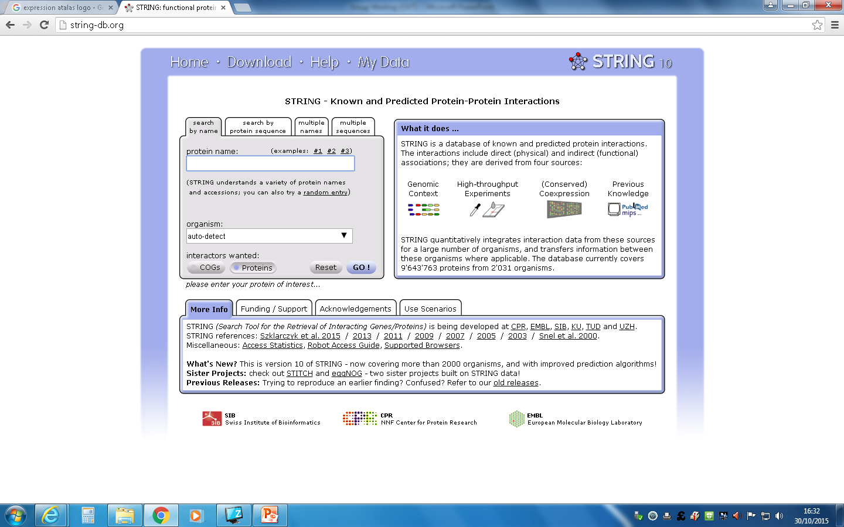
PMGM00:Bioinformatics for Genome Analysis
Databases and Tools to Analysis Genomic-Variants
Databases for Functional Annotation of Gene/Proteins
Notes:
1st in the UK for Research Environment, 2nd in the UK for Research Quality – Research Framework (Research Excellence Framework 2014)
.
Postgraduate students have access to facilities in the £100 million Institute of Life Science building
.
What Uni? Student Choice Award 2017 Winner – Postgraduate
.
Degree is available as either one year full time or part-time over three years
.
Strong links with the NHS and organisations within the Life Science Sector
.
Strong collaborative links with colleagues from the Centre for Health Services Research of the University of Western Australia, a group of leading experts in the analysis of linked health data
.
Hands on experiential learning from the professionals behind the Secure Anonymised Information Linkage (SAIL) Databank, a UK-exemplar project for the large scale mining of healthcare data within a secure environment

Slide 14
PMGM00:Bioinformatics for Genome Analysis
Week Structure
Day
Monday | Introduction Lecture
 | Sequence Alignment Lecture and Workshop
Tuesday | Basic Databases Lecture and Workshop
 | Variant Nomenclature Lecture and Workshop
Wednesday | Frequency Databases Lecture and Workshop
 | Predicted Protein Pathogenicity Lecture and Workshop
Thursday | Functional Annotation Lecture and Workshop
 | Self Led Learning and Presentation Prep
Friday | Presentations
 | MCQs
Format: Lecture followed by a workshop.
Workshops build through the week leading to an informal presentation at the end of the week.
Notes:
1st in the UK for Research Environment, 2nd in the UK for Research Quality – Research Framework (Research Excellence Framework 2014)
.
Postgraduate students have access to facilities in the £100 million Institute of Life Science building
.
What Uni? Student Choice Award 2017 Winner – Postgraduate
.
Degree is available as either one year full time or part-time over three years
.
Strong links with the NHS and organisations within the Life Science Sector
.
Strong collaborative links with colleagues from the Centre for Health Services Research of the University of Western Australia, a group of leading experts in the analysis of linked health data
.
Hands on experiential learning from the professionals behind the Secure Anonymised Information Linkage (SAIL) Databank, a UK-exemplar project for the large scale mining of healthcare data within a secure environment

Slide 15
PMGM00:Bioinformatics for Genome Analysis
Assessments
Multiple Choice Questions (MCQs) - 20%
Completed at the end of the week.
Bioinformatics Analysis - 20%
Similar structure to the workshops.
Bioinformatics Report - 60%
Essay.
Notes:
1st in the UK for Research Environment, 2nd in the UK for Research Quality – Research Framework (Research Excellence Framework 2014)
.
Postgraduate students have access to facilities in the £100 million Institute of Life Science building
.
What Uni? Student Choice Award 2017 Winner – Postgraduate
.
Degree is available as either one year full time or part-time over three years
.
Strong links with the NHS and organisations within the Life Science Sector
.
Strong collaborative links with colleagues from the Centre for Health Services Research of the University of Western Australia, a group of leading experts in the analysis of linked health data
.
Hands on experiential learning from the professionals behind the Secure Anonymised Information Linkage (SAIL) Databank, a UK-exemplar project for the large scale mining of healthcare data within a secure environment

Slide 16
PMIM102: Scientific Computing in Healthcare
The module aims to raise the awareness of students about scientific computing in the field of health data science. It focuses on basic software development workflows, tools, and skills that health data scientists most often employ. Students will also learn about the professional context within which health data scientists operate.
MONTH | MODULE | WEB ACCESS | TAUGHT WEEK | STUDY GROUP | TUTORIAL | ASSIGNMENT DATE | WRITING TIME | PROVISIONAL MARKS
JAN 2021 FT | PMIM102 Scientific Computing and Health Care Mr Dan Thayer | 04/01/21 | 18/01/21 | 27/01/21 | 19/02/21 | 08/03/21 | 6 weeks | 29/03/21
Module co-ordinator: Dan Thayer
Notes:
1st in the UK for Research Environment, 2nd in the UK for Research Quality – Research Framework (Research Excellence Framework 2014)
.
Postgraduate students have access to facilities in the £100 million Institute of Life Science building
.
What Uni? Student Choice Award 2017 Winner – Postgraduate
.
Degree is available as either one year full time or part-time over three years
.
Strong links with the NHS and organisations within the Life Science Sector
.
Strong collaborative links with colleagues from the Centre for Health Services Research of the University of Western Australia, a group of leading experts in the analysis of linked health data
.
Hands on experiential learning from the professionals behind the Secure Anonymised Information Linkage (SAIL) Databank, a UK-exemplar project for the large scale mining of healthcare data within a secure environment

Slide 17
PMIM102: Learning Outcomes
Examine the main mission, operational environment and characteristic skill set of health data scientists.
Design algorithms to solve representative categories of problems that frequently occur in healthcare scientific computation.
Write, document, and test computer code to solve data processing problems.
Prepare and compose comprehensive documentation of code that enables its evaluation and re-use by other professionals.
Appraise secondary uses of data in healthcare

Slide 18

PMIM102: Timetable
Date | Time |  | Subject | Lecturers | Room
Date | Time |  | Subject | Lecturers | Room
Mon 18th Jan 2021 | 09:00 | 09:30 | Welcome, Introduction, Options. | Pete Arnold | Zoom
 | 09:30 | 10:30 | What is data science? | Dan Thayer | Zoom
 | 10:30 | 11:00 | Introduction to the tools used in the course. | Dan Thayer | Zoom
 | 11:00 | 12:00 | Lab: Computer setup Check your installation and setup of R, R-Studio, Jupyter & git. Introduction to git version control. | Dan Thayer Pete Arnold | Zoom
 | 12:00 | 13:00 | Interactive: Getting started with R Getting started with the tools. R-Studio / Jupyter notebooks / git | Pete Arnold | Zoom
 | 13:00 | 14:00 | Lunch
 | 14:00 | 15:30 | Interactive: Introduction to R Basic concepts in R. Exercises in programming, git and R. R-Studio / Jupyter notebooks / git | Pete Arnold | Zoom
 | 15:30 | 16:00 | Coffee break
 | 16:00 | 17:00 | Interactive: Introduction to R (ctd) Basic concepts in R with examples from github. R-Studio / Jupyter notebooks / git | Dan Thayer Pete Arnold | Zoom
Date | Time |  | Subject | Lecturers | Room
Tue 19th Jan 2021 | 09:00 | 09:15 | Introduction, feedback and questions from previous day. | Pete Arnold | Zoom
 | 09:15 | 12:00 | Interactive: R: wrangling + stats. Introducing the tidyverse & statistics in R. R-Studio / Jupyter notebooks / git | Pete Arnold | Zoom
 | 12:00 | 13:00 | Lunch
 | 13:00 | 15:00 | Statistics I | Alan Watkins | Zoom
 | 15:00 | 15:30 | Coffee break
 | 15:30 | 17:00 | Interactive: Using statistics in R. R-Studio / Jupyter notebooks / git | Pete Arnold Alan Watkins | Zoom
Date | Time |  | Subject | Lecturers | Room
Wed 20th Jan 2021 | 09:00 | 09:15 | Introduction, feedback, and questions from previous day | Pete Arnold Dan Thayer | Zoom
 | 09:15 | 10:00 | Health Data 2 | Dan Thayer | Zoom
 | 10:00 | 11:30 | Library Skills | Suzanne Taylor | Zoom
 | 11:30 | 13:30 | Introduction to SQL | Dan Thayer | Zoom
 | 13:30 | 14:30 | Lunch
 | 14:30 | 15:30 | Lab: SQL PostgreSQL | Dan Thayer | Zoom
 | 15:30 | 16:00 | Coffee break
 | 16:00 | 17:00 | Working with both SQL & R PostgreSQL / R-Studio | Dan Thayer | Zoom
Date | Time |  | Subject | Lecturers | Room
Thu 21st Jan 2021 | 09:00 | 10:00 | Health Data 3 | Dan Thayer | Zoom
 | 10:00 | 11:00 | Database design | Dan Thayer | Zoom
 | 11:00 | 12:30 | Software development principles: Using functions and modules in R. R-Studio / git | Marcos del pozo Baños | Zoom
 | 12:30 | 13:30 | Lunch
 | 13:30 | 15:00 | Lab: Functions in R R-Studio | Marcos del pozo Banos | Zoom
 | 15:00 | 15:30 | Coffee break
 | 15:30 | 17:00 | Interactive: Further R. More R and Tidyverse for statistics. R-Studio / Jupyter notebooks / git | Pete Arnold | Zoom
Date | Time |  | Subject | Lecturers | Room
Fri 22nd Jan 2021 | 09:00 | 10:30 | Software project management + Lab session R-Studio | Dan Thayer | Zoom
 | 10:30 | 11:30 | Health data user Q&A | David Tucker | Zoom
 | 11:30 | 12:30 | Academic Integrity Training | Warren Perkins | Zoom
 | 12:30 | 13:30 | Lunch
 | 13:30 | 15:30 | Advanced SQL: joins, aggregate functions PostgreSQL / R-Studio | Dan Thayer | Zoom
 | 15:30 | 16:00 | Coffee break
 | 16:00 | 16:30 | Course evaluation | Pete Arnold | Zoom
 | 16:30 | 17:00 | Assignment discussion Lab session / surgery | Dan Thayer | Zoom

Slide 19
PMIM102:Practicalities
Sessions will be delivered face-to-face and on Zoom.
All students should have a connection to Zoom (including those face-to-face).
Face-to-face students should mute their microphones and speakers – there is a room mic / speaker.
Face-to-face students – you have a desk, this will be your desk for the whole week, clean your desk at the start of the day and before you leave.
There are no refreshment facilities such as coffee machines, microwaves, kettles. - you can eat/drink at your desk if you wish.

Slide 20
PMIM102:Practicalities
Wash / sanitise your hands as you leave and enter the teaching space / building.
When you use the toilet please wipe the toilet seat and basin before and after use.
Please wear a face-mask when you move around the building and at other times unless this impedes your ability to work – e.g. Speaking or steaming up glasses etc.
The desks are spaced so that the chairs are socially distanced.
Collaborative work will be organised via breakout rooms on Zoom or discussion boards on Canvas.

Slide 21
Thankyou
Any questions?

